Slide 1
EMPLOYEE CHURN ANALYSIS
Report

Slide 2
CONTENTS
Attrition Rate
Average Daily Wage
Average Distance from Home
Total employees travelling kms as per each category
Attrition Rate by Age Group
Attrition Rate by Department
Total employees working in Sales team with bifurcation of Gender
The average Daily wage of each dept
The top 5 earning employees alongside their Gender and Education field
Trends or patterns in the Department employee allocation

Slide 3
Attrition Rate:
The overall attrition rate is 17%. This indicates that 17% of the employees have left the company, which can be considered high depending on the industry standards.
Average Daily Wage:
The average daily wage is 818.98. This gives an overview of the company's compensation level, which might be compared to industry standards to gauge competitiveness.
Average Distance from Home:
The average distance from home is 8.95 km. This suggests that most employees live relatively close to their workplace.

Slide 4
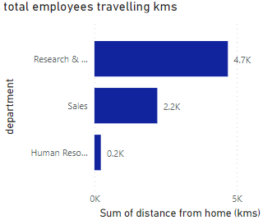
Total employees traveling kilometers by department
- Research & Development has the highest average daily wage and the highest total distance traveled.

Slide 5
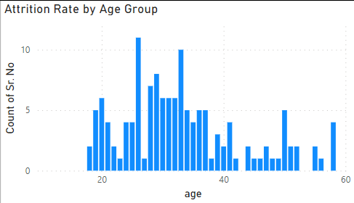
Attrition Rate by Age Group
-Higher attrition rates are observed in employees aged between 20-30 and above 50. This could indicate job dissatisfaction among younger employees or retirement and job change among older employees.

Slide 6
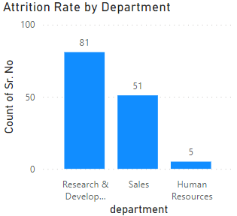
Attrition Rate by Department
Research & Development has the highest attrition rate, followed by Sales. Human Resources has the lowest attrition rate.

Slide 7
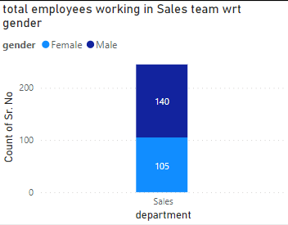
total employees working in Sales team with bifurcation of Gender
- Sales team has a significant gender disparity, with more males than females.

Slide 8
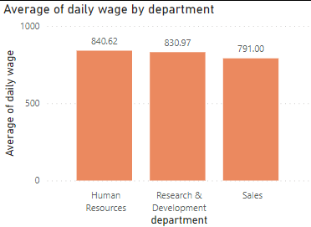
the average Daily wage of each dept
-Human Resources has the highest average daily wage..

Slide 9
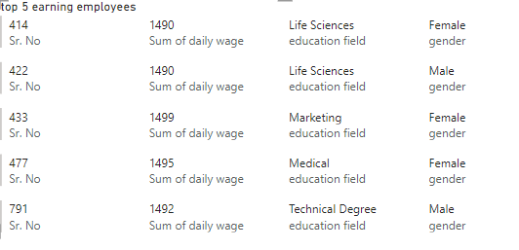
the top 5 earning employees alongside their Gender and Education field
-Employee 433 is the highest paid employee and she is from marketing educational background.

Slide 10
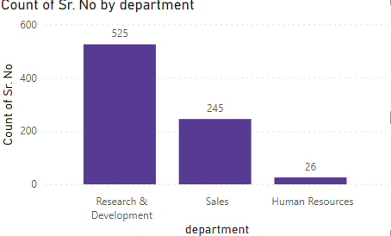
trends or patterns in the Department employee allocation
Research & Development has the highest number of employees.

Slide 11
Insights
Attrition Rate:
17% of employees are leaving, which is high.
Average Daily Wage:
818.98, indicating overall compensation level.
Average Distance from Home:
8.95 km, employees live close to work.
Gender Distribution in Sales:
140 males and 105 females, more males in Sales.
Daily Wage by Department:
Highest in HR (840.62), followed by R&D (830.97), and Sales (791.00).
Attrition by Age:
High attrition among employees aged 20-30 and above 50.
Attrition by Department:
Highest in R&D, followed by Sales. Lowest in HR.
Travel Frequency:
R&D employees travel the most.

Slide 12
Possible Reasons for Employee Attrition
Job Dissatisfaction:
Younger employees might feel a lack of career growth, challenging tasks, or mentorship, leading to job dissatisfaction.
Older employees might leave due to lack of flexible working options, job stress, or retirement plans.
Work-Life Balance:
High travel frequency in the Research & Development department might lead to poor work-life balance, causing employees to leave.
Career Development:
Limited opportunities for career advancement and professional growth can cause employees to seek opportunities elsewhere.

Slide 13
Recommendations
Reduce Attrition in Key Age Groups:
Young Employees (20-30): Offer career development and mentorship.
Older Employees (50+): Provide flexible work options.
Improve Conditions in High Attrition Departments:
Investigate reasons for high attrition in R&D and address them.
Review Compensation:
Ensure wages are competitive and offer additional benefits.
Enhance Work-Life Balance:
Implement wellness programs and flexible working options.
Reduce Travel Burden:
Offer better travel accommodations and remote work solutions.

Slide 14
THANK YOU

